Slide 1
Automated wafer loading system design with CAD
Thesis Maximilian Boss
Mechatronics and robotics
Semester 2024

Slide 2
Description of all parts
All parts and funcitons will get explained in the following slides

Slide 3
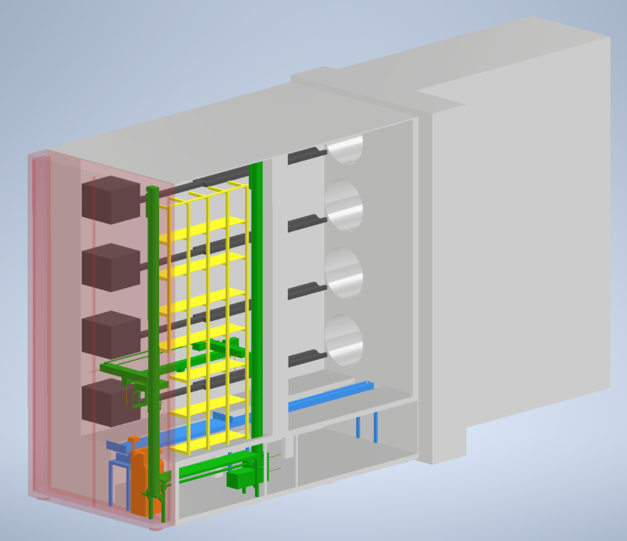
Automatic loading and unloading mechanism
1 Moving element and 3 stations
Transfer system (green)
Transport system (blue)
Storage for magazines (yellow)
Wafer-Batch-Transfer-System (orange)

Slide 4
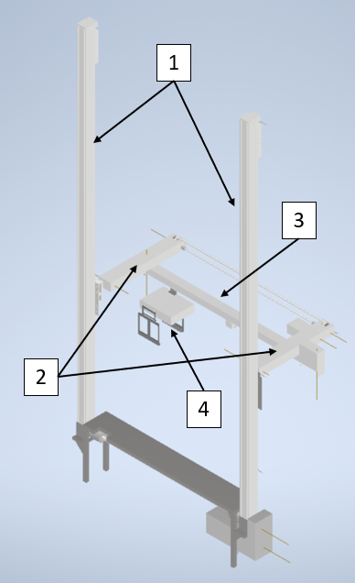
Transfer system
Portal axis (1)
Arm axis (2)
Hand axis (3)
Handler (4)

Slide 5
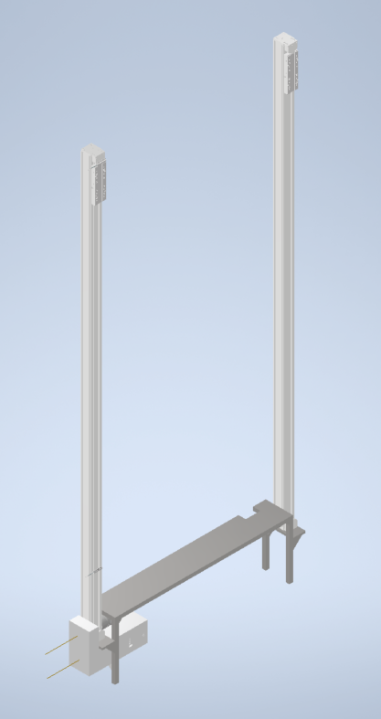
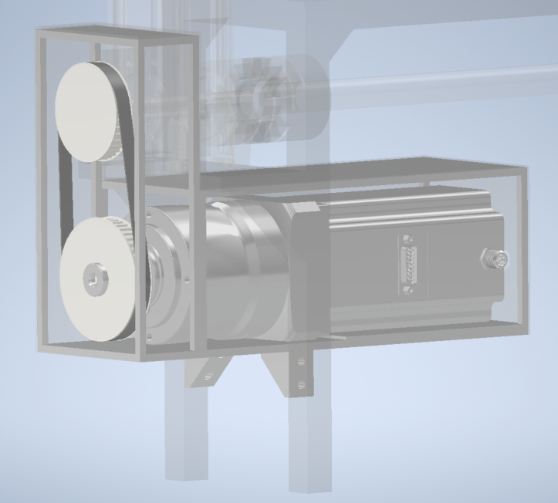
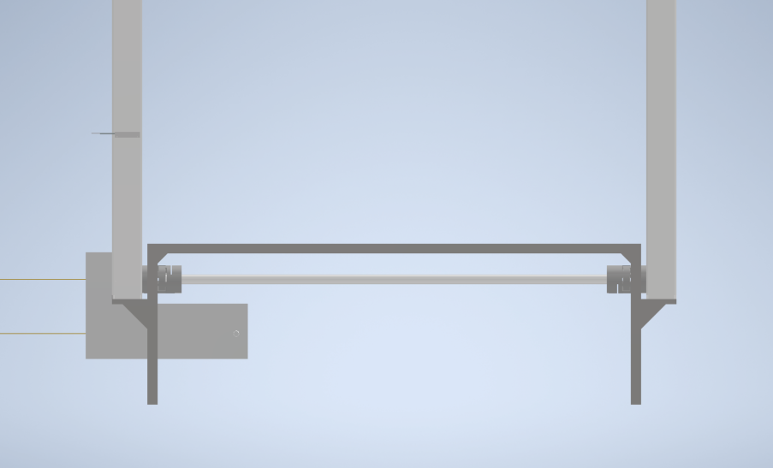
Portal axis
In charge of moving up and down
Contains 2 linear systems
Connected with a shaft
Steering and control with a motor with encoder
Main support element for whole construction
Integrated sensors for localization and position analysis

Slide 6
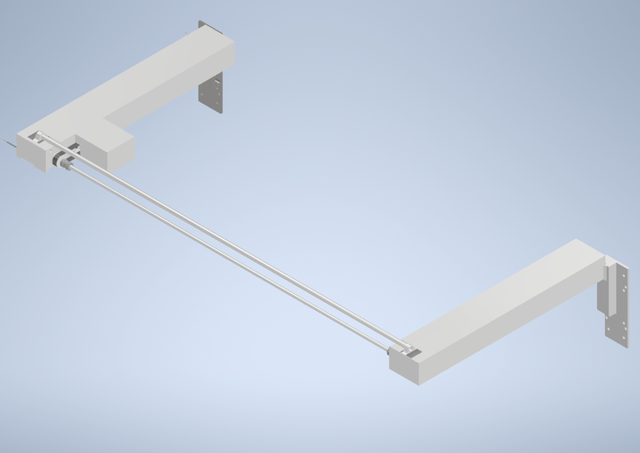
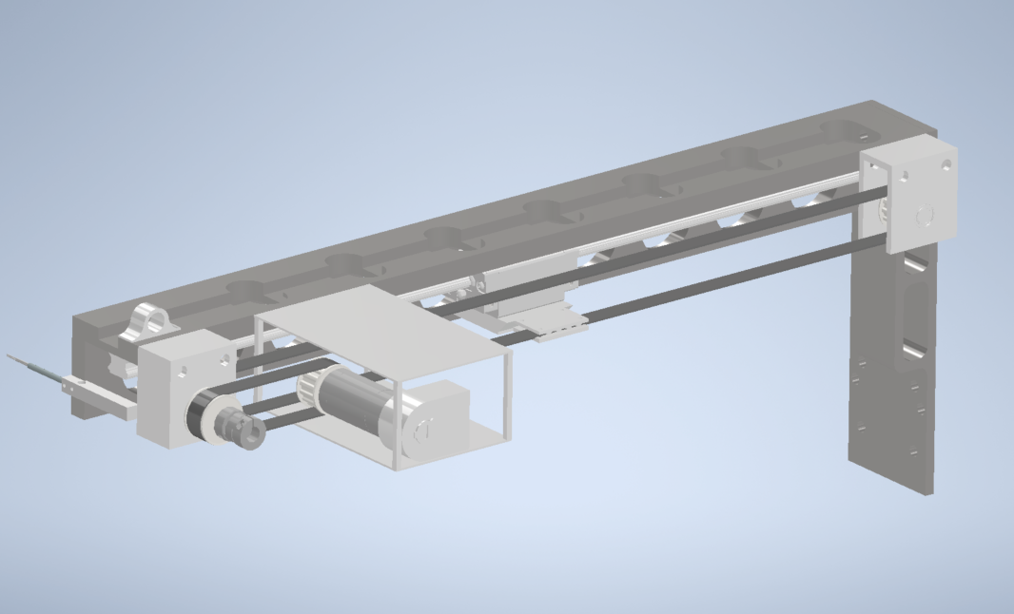
Arm axis
In charge of moving in and out of machine
Contains two arms with a linear system
Controlled and moved with motor with encoder and timing belt drive
Arms are connected through a shaft and cable chanel
Connected directly to the portal axis
Integrated sensors for localization and position analysis

Slide 7
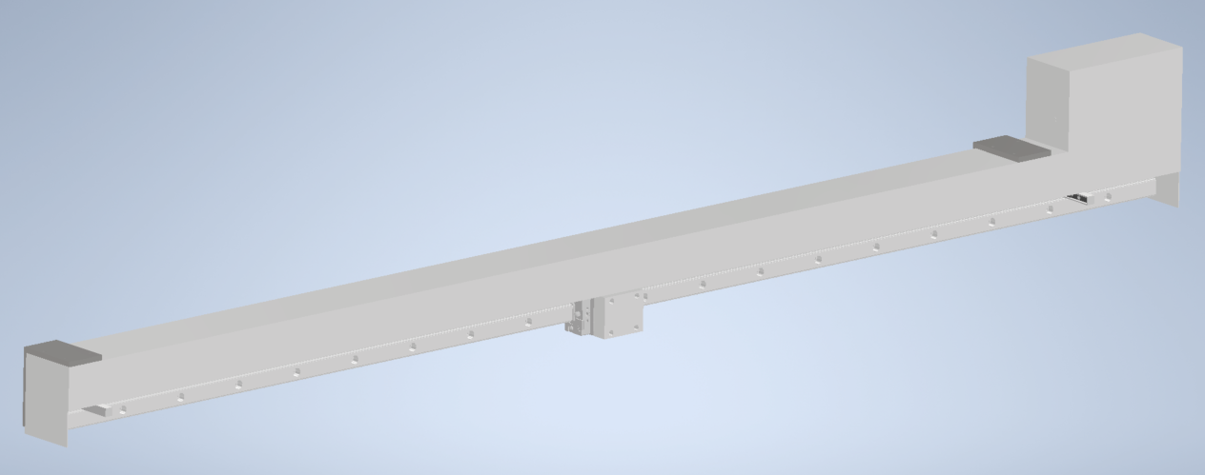
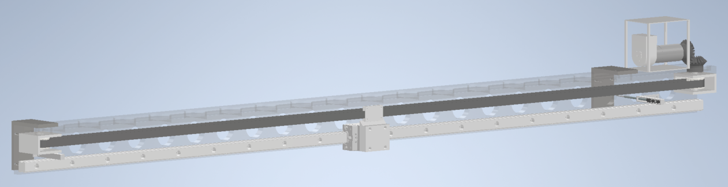
Hand axis
In charge of moving side to side
Contains one linear system
Controlled and moved with motor with encoder and timing belt drive
Connected directly to the arm axis and gripper
Integrated sensors for localization and position analysis

Slide 8
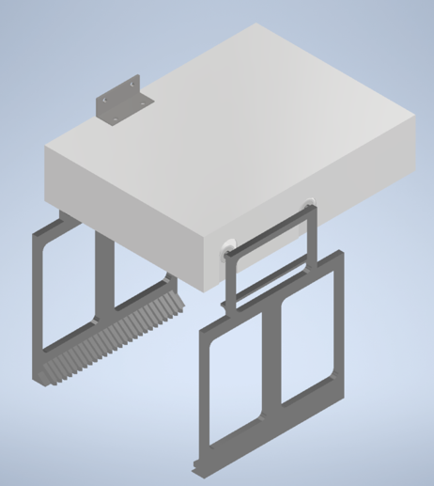
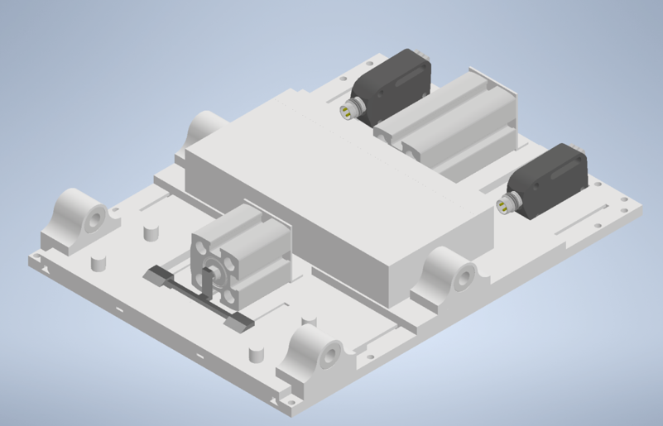
Gripper
Moves wafer and magazines
Gripping system can hold up to 25 wafers or a whole magazine
Contains:
2 gripper jaws
4 supports
3 plates
2 cylinders
2 sensors
1 mechanism to open
1 mechanism to tilt the gripper jaws

Slide 9
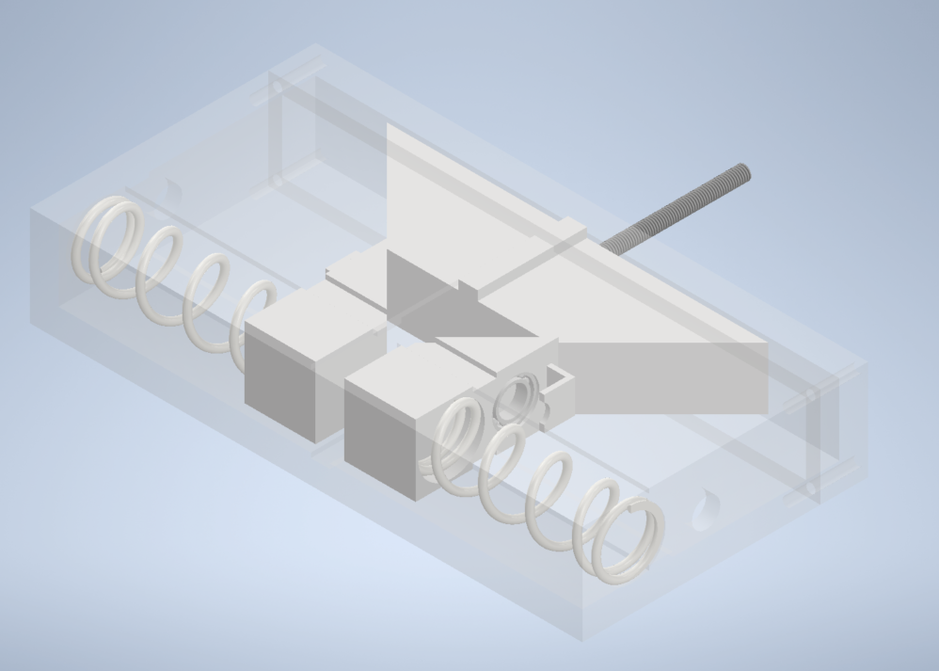
Mechanism to open/close gripper jaws
Opens and closes the gripper jaws
Moving part connected to a cylinder to separate the spring-loaded gripper jaws
Springs to hold wafer and magazines
Support for gripper jaws

Slide 10
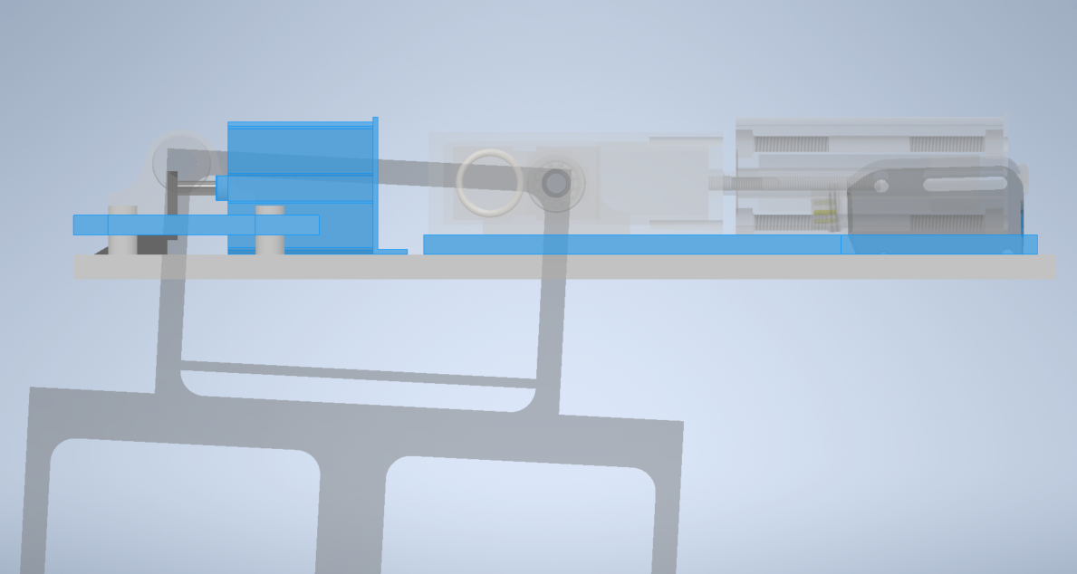
Mechanism to tilt gripper jaws
Tilts the gripper jaws to align the wafer during loading
Moving part connected to a cylinder, with upwards movement it tilts the gripper jaws
Notes:
Warum Neigung? Da Wafer geneigt in Booten, um homogenen Prozessverlauf zu garantieren und Stabilität der Wafer alle gleich in Booten stehen

Slide 11
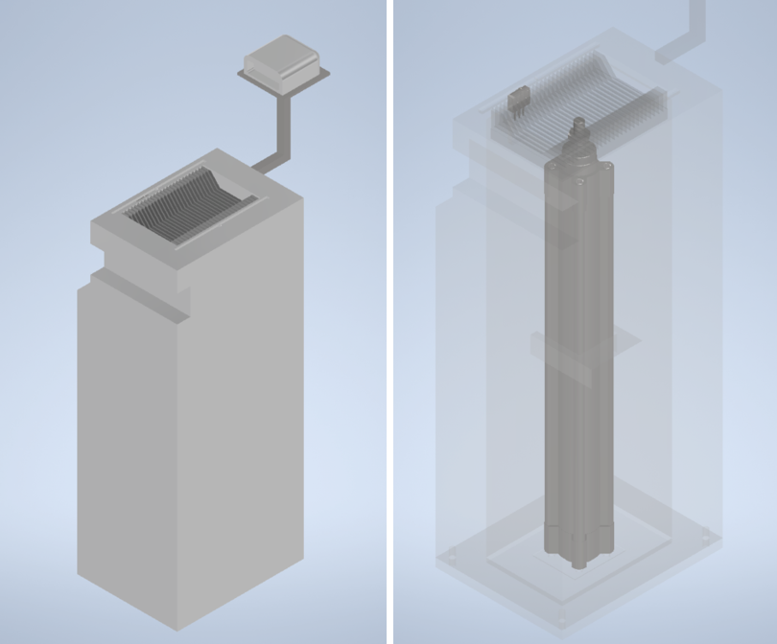
Wafer-Batch-Transfer-System
Pushes wafer out of magazin
Moved by a pneumatic cylinder
Connected to a designed wafer holding system
Integrated barcode-scanner
Sensors to detect the magazines

Slide 12
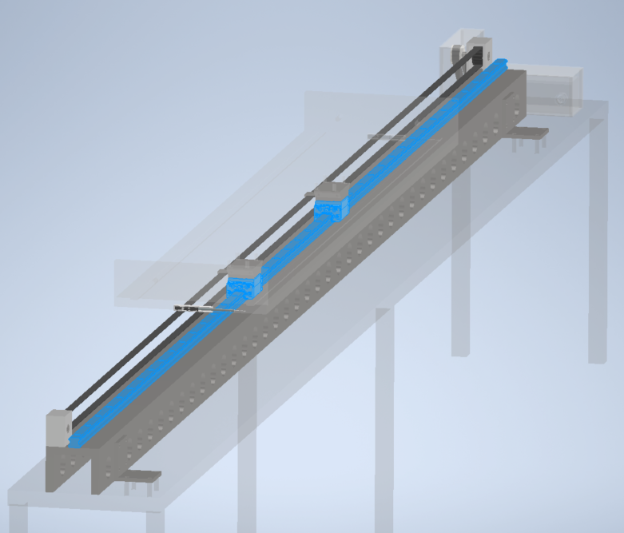
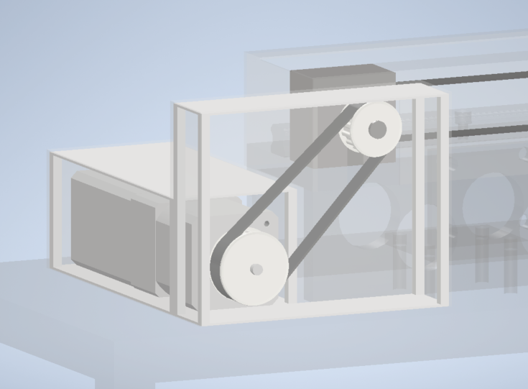
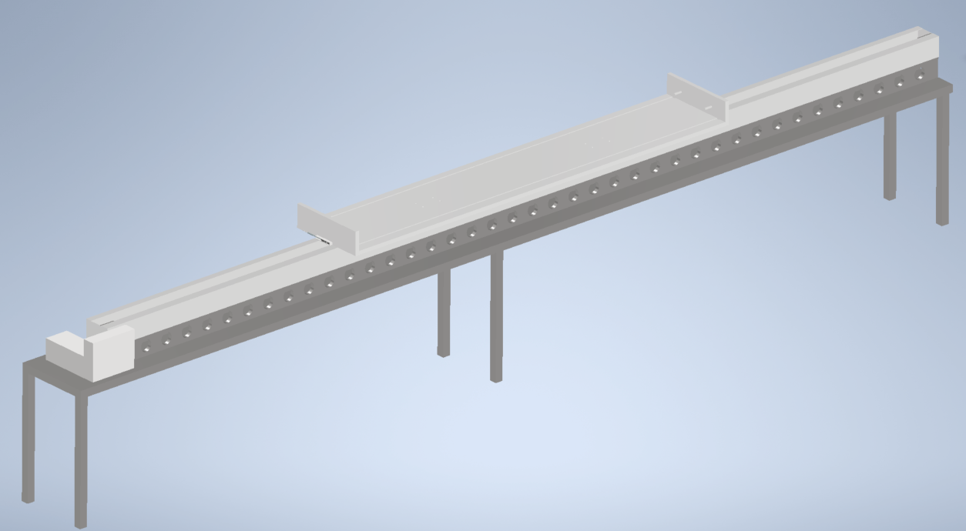
Transport system
Moves and stores the wafer and magazines from loading station to transfer station
Moved through a linear axis
Controlled and moved with motor with encoder and timing belt drive
Integrated sensors for localization and position analysis

Slide 13
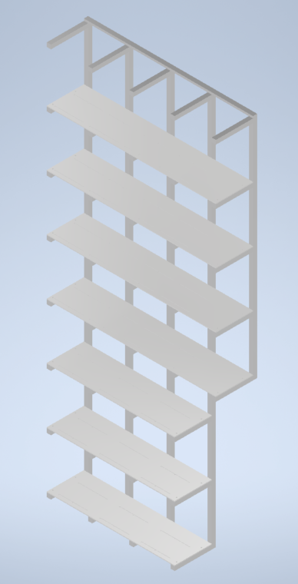
Included storage system
Storage system for up to 25 magazines
Contains two parts:
External storage
Internal storage

Slide 14
How does it work?
An explanation of the process of loading and unloading

Slide 15
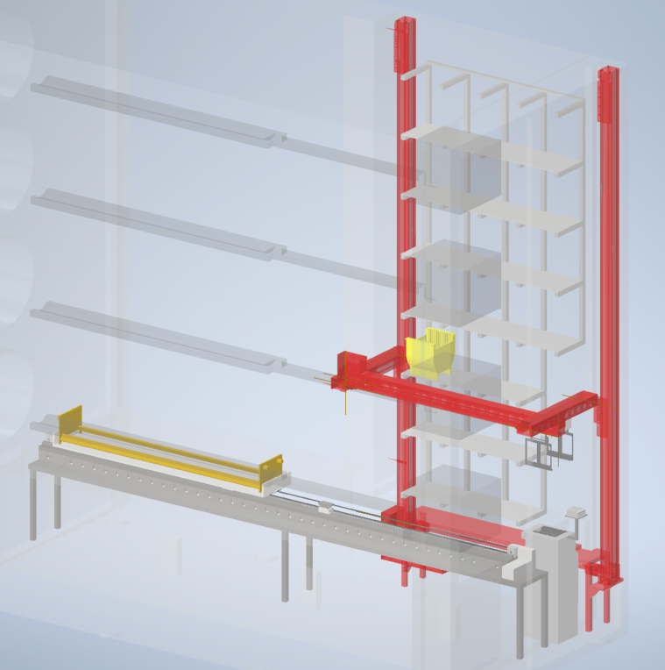
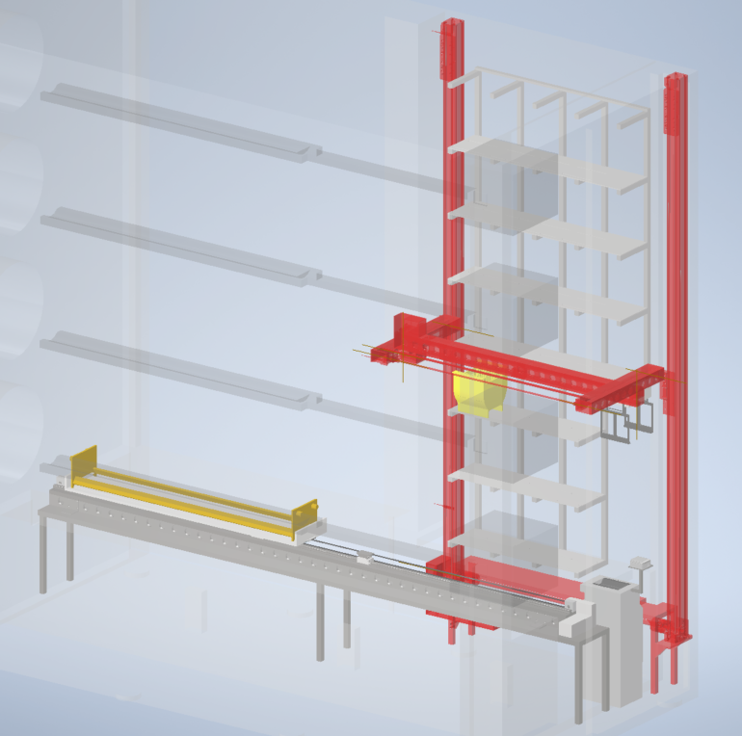
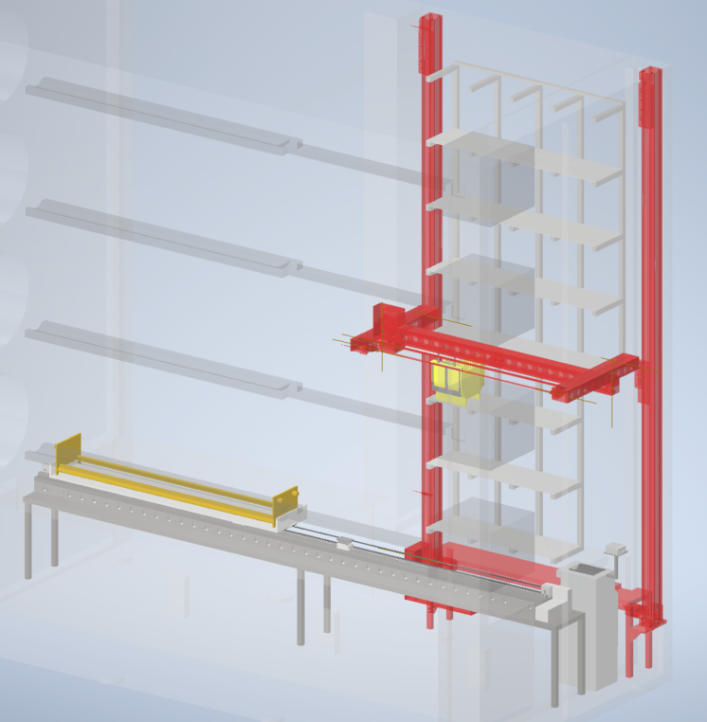
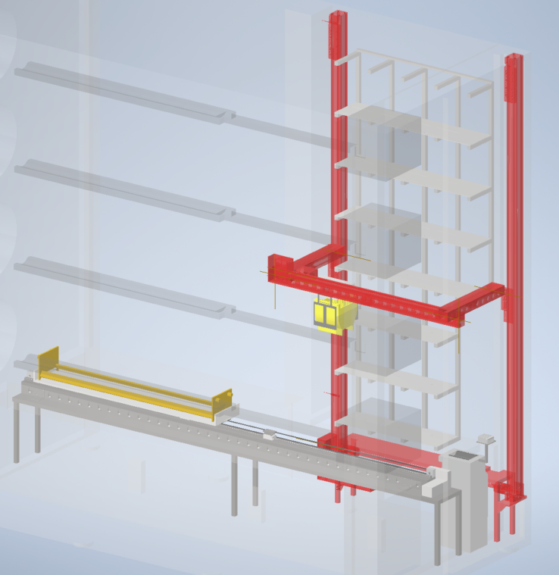
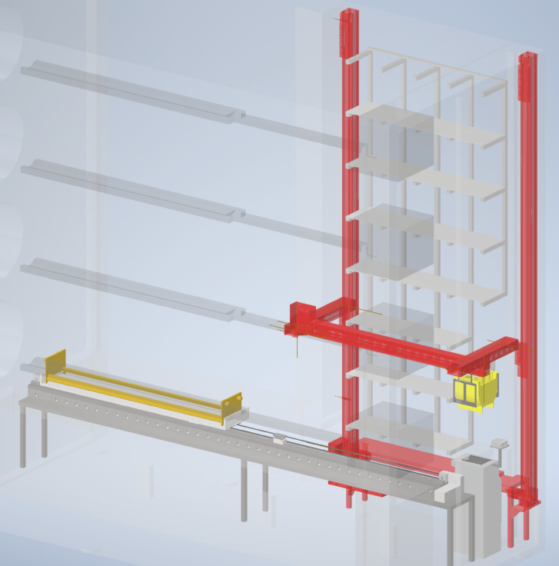
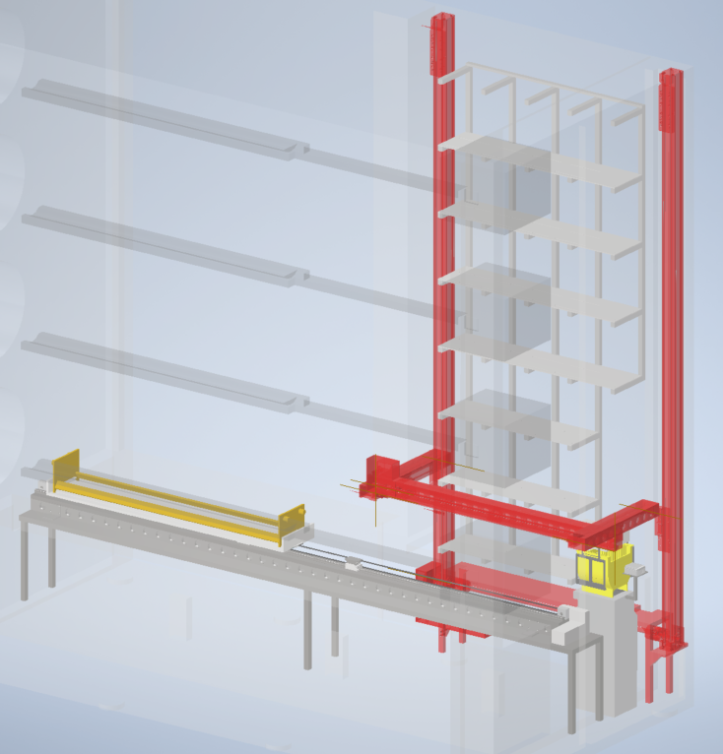
1
2
3
4
5
6

Slide 16
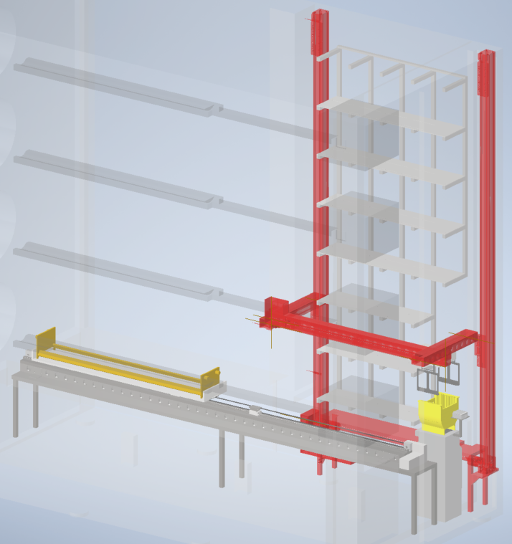
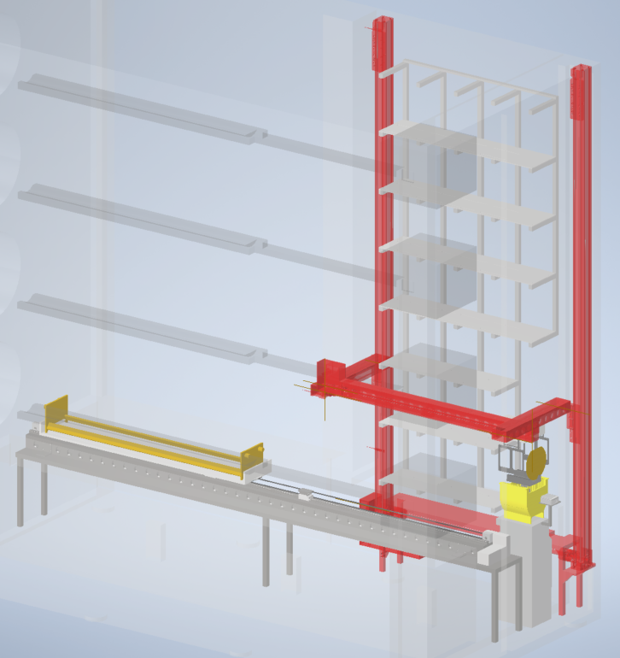
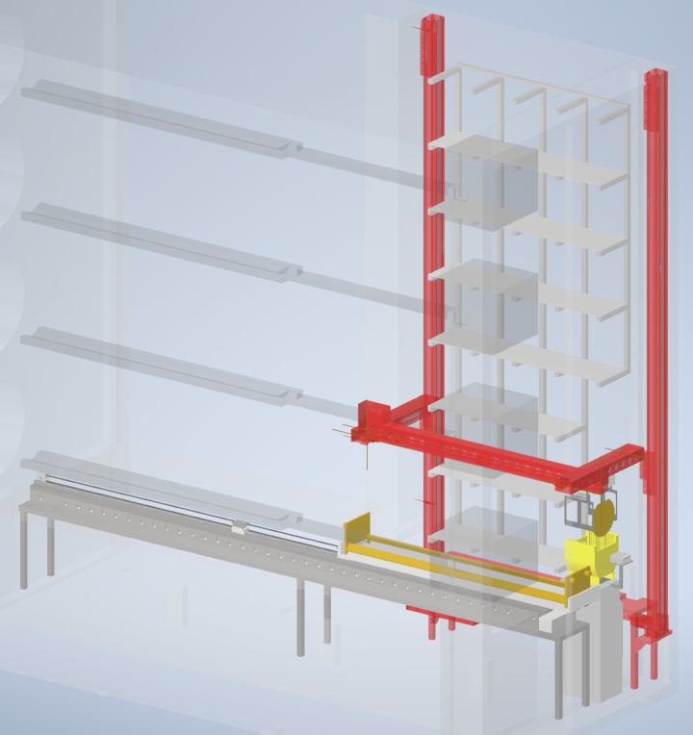
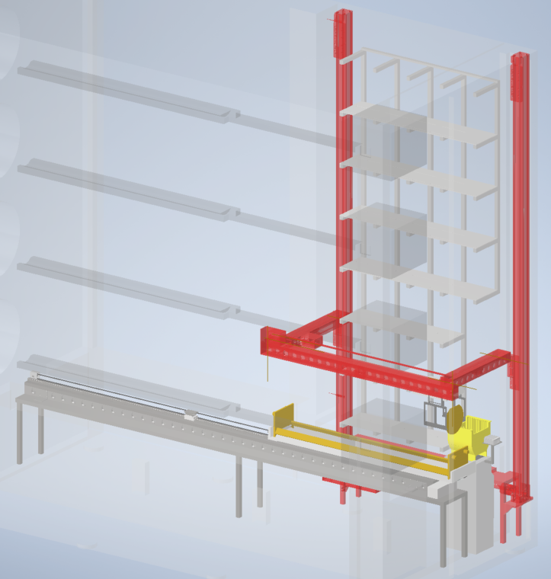
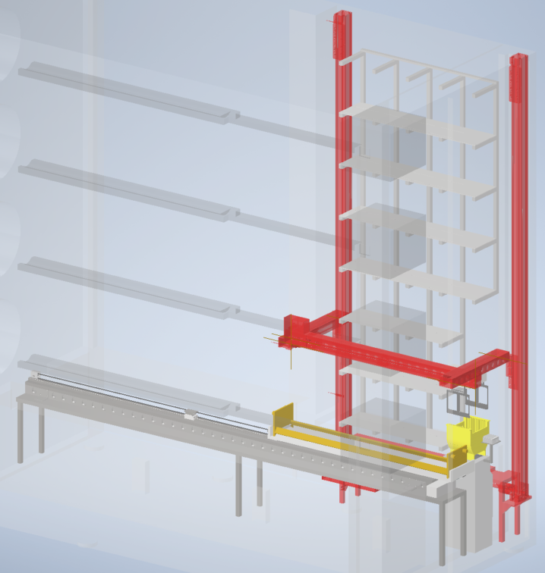
7
8
9
10
11

Slide 17
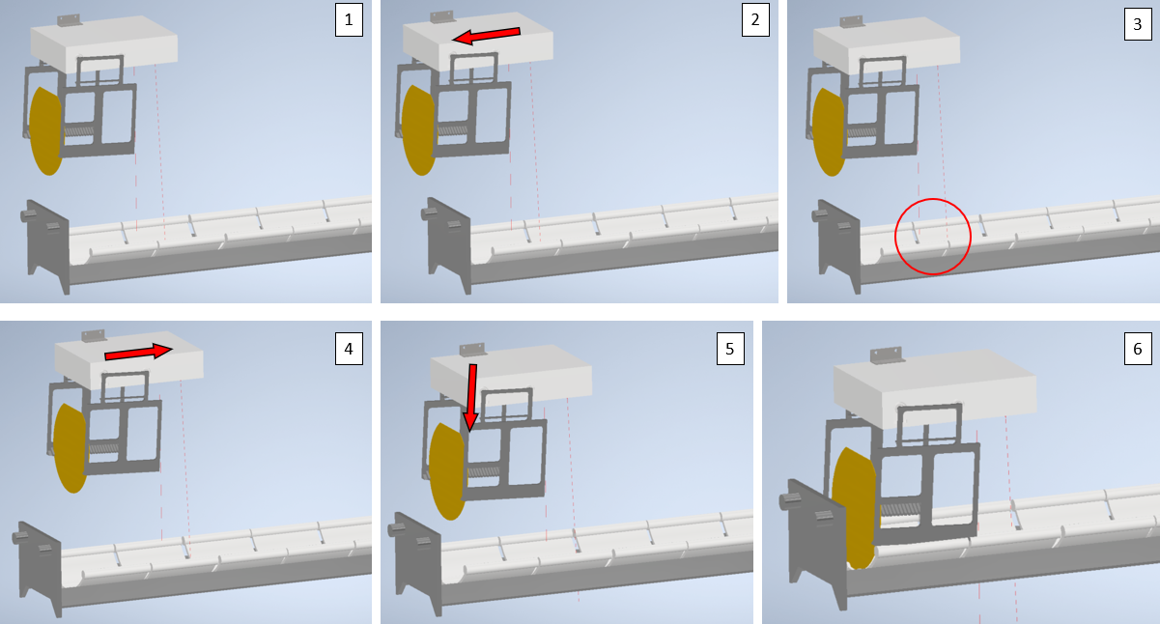
Loading process
Notes:
Greifer senkt sich in 3° Winkel parallel zu Kerben im Boot ab, um Wafer exakt zu platzieren
Weitere Boote werden durch hochzählen eines Counters erkannt und beladen

Slide 18
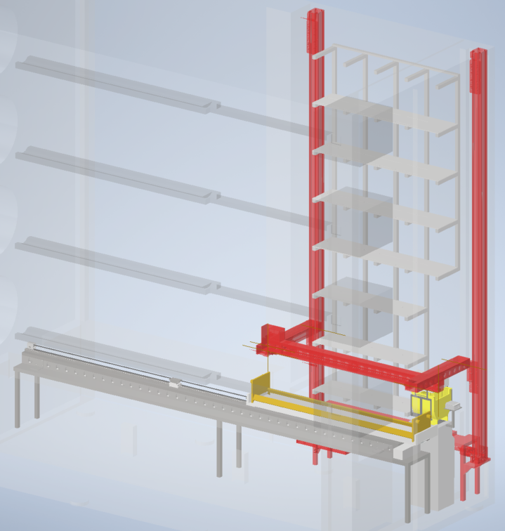
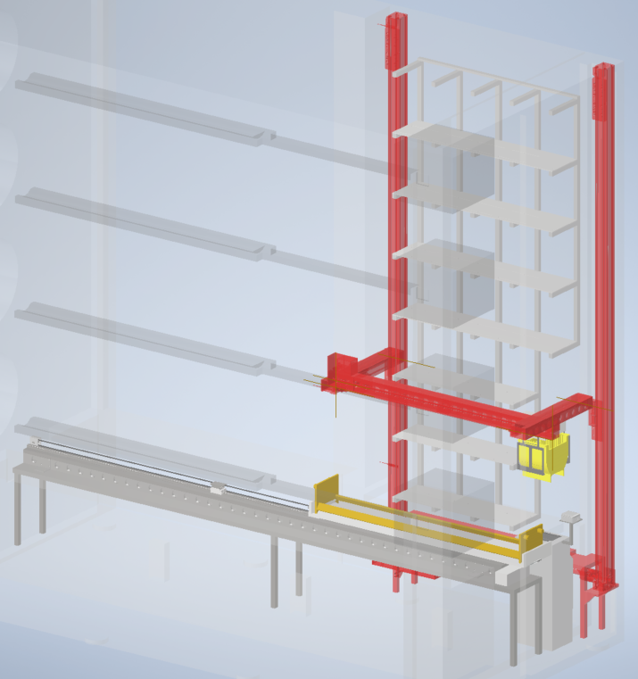
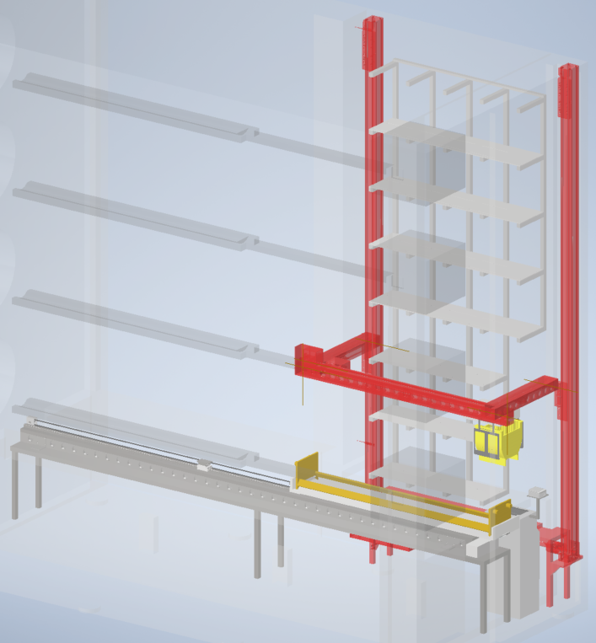
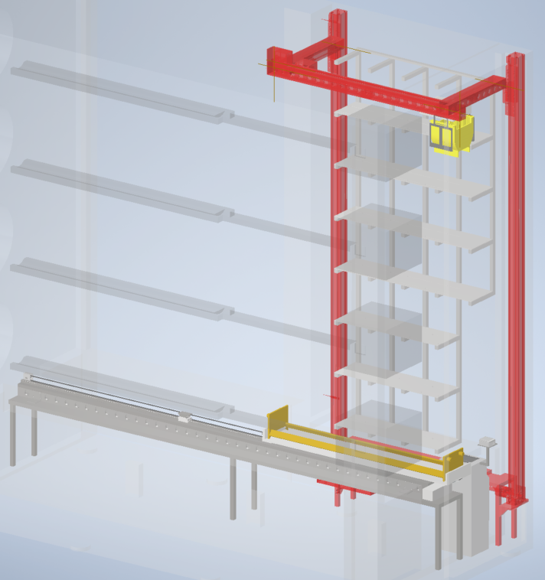
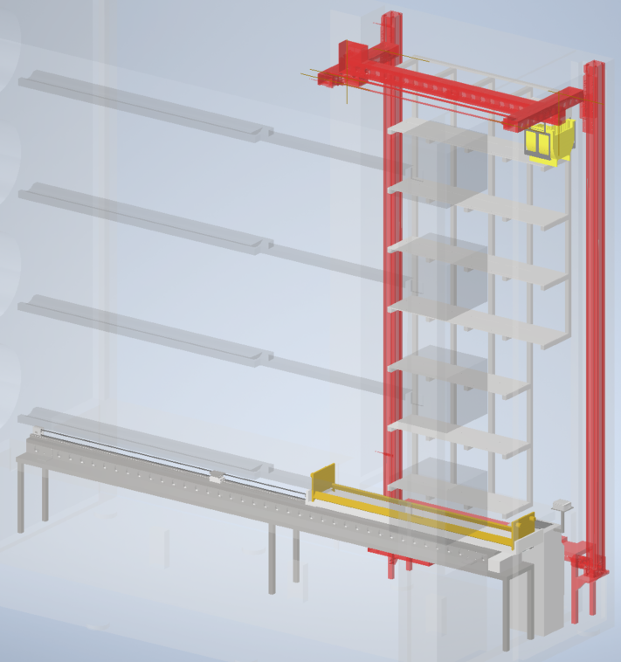
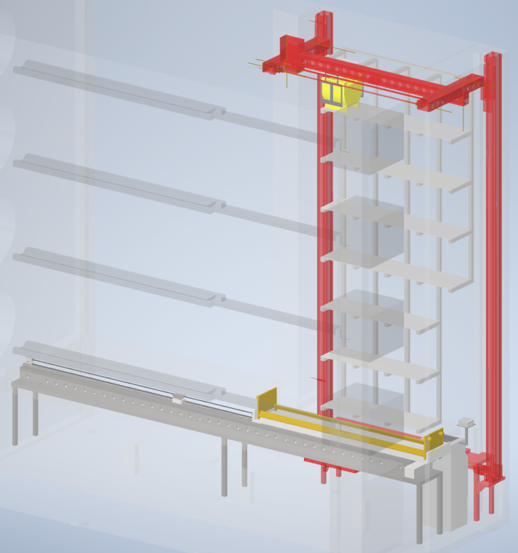
12
13
14
15
16
17

Slide 19
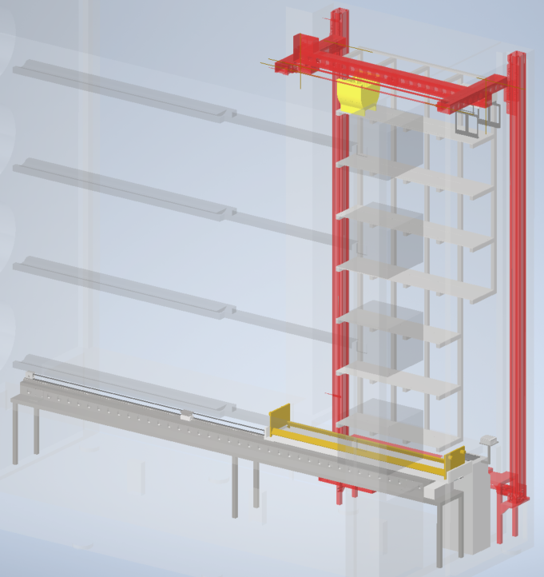
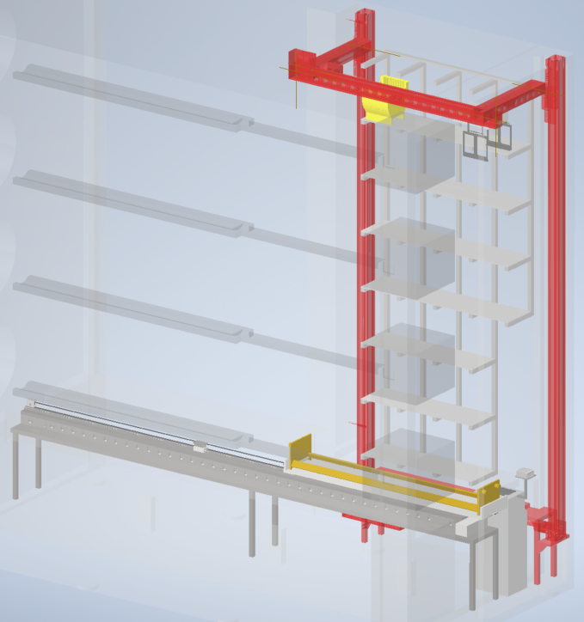
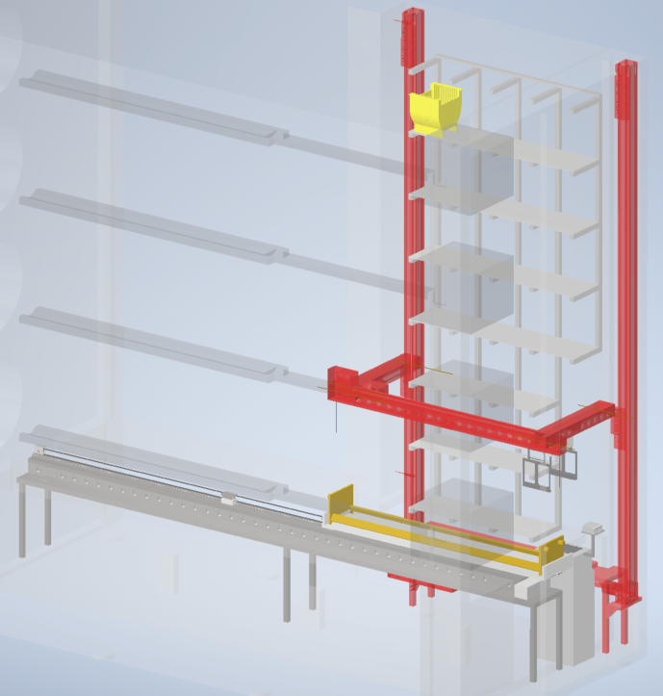
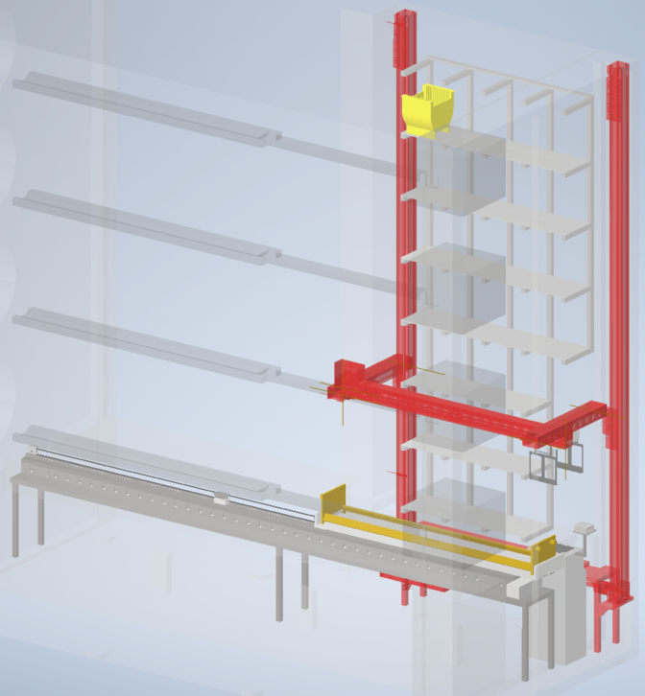
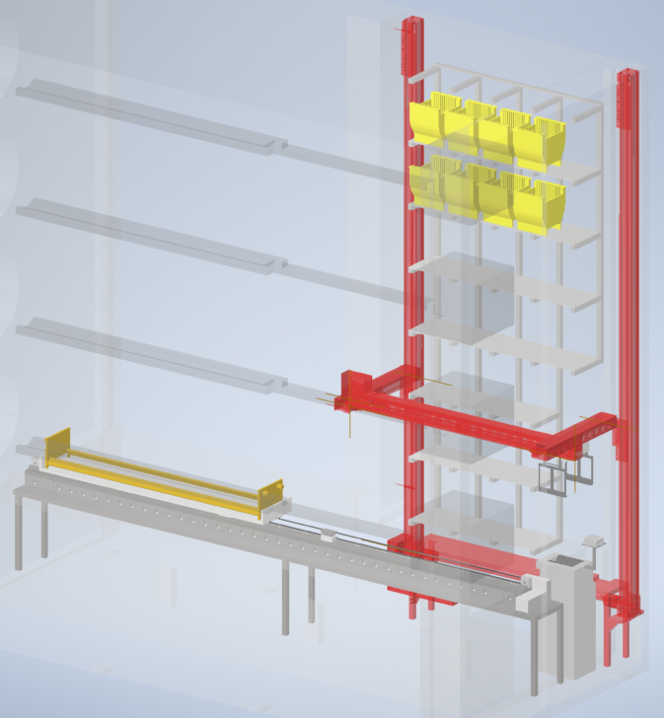
18
19
20
21
22

